Slide 1

Types of Data

Slide 2
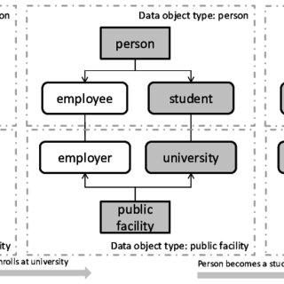
Data Objects
Datasets are made up of data objects.
A data object represents an entity
in a sales database, the objects may be customers, store items, and sales;
in a medical database, the objects may be patients;
in a university database, the objects may be students, professors, and courses.
Data objects are typically described by attributes.
Data objects can also be referred to as samples, examples, instances, data points, or objects.
If the data objects are stored in a database, they are data tuples. That is, the rows of a database correspond to the data objects, and the columns correspond to the attributes.

Slide 3
Attributes
An attribute is a data field, representing a characteristic or feature of a data object.
The nouns attribute, dimension, feature, and variable are often used interchangeably in the
literature.
The term dimension is commonly used in data warehousing.
Machine learning literature tends to use the term feature, while statisticians prefer the term variable.
Attributes describing a customer object can include, for example, customer ID, name, and address.
A set of attributes used to describe a given object is called an attribute vector (or feature vector).

Slide 4
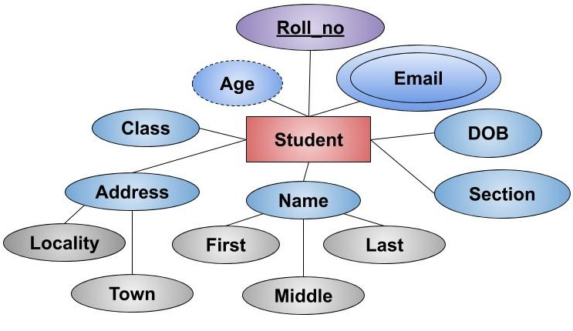
Attribute Types
The type of an attribute is determined by the set of possible values:
nominal,
binary,
ordinal, or
numeric

Slide 5
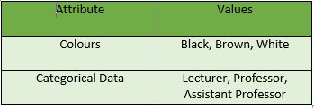
Nominal Attributes
Nominal means “relating to names.”
The values of a nominal attribute are symbols or names of things.
Each value represents some kind of category, code, or state, and so on.
Nominal attributes are also referred to as categorical.
The values do not have any meaningful order.
In computer science, the values are also known as enumerations.

Slide 6
Nominal Attributes
Examples:
Hair_color= {auburn, black, blond, brown, grey, red, white}
Occupation = {teacher, dentist, programmer, farmer, …}
marital status, occupation, ID numbers, zip codes.

Slide 7
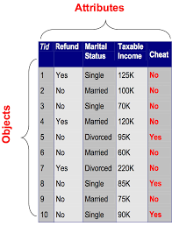
Binary Attributes
A binary attribute is a nominal attribute with only two categories or states: 0 or 1, where 0 typically means that the attribute is absent, and 1 means that it is present.
Binary attributes are referred to as Boolean if the two states correspond to true and false.
Notes:
Because nominal attribute values do not have any meaningful order about them and are not quantitative, it makes no sense to find the mean (average) value or median (middle) value for such an attribute, given a set of objects.

Slide 8


Binary Attributes
For example:
{Non-smoker: 0, Smoker: 1}
{negative test result: 0, positive test result: 1}
Notes:
Because nominal attribute values do not have any meaningful order about them and are not quantitative, it makes no sense to find the mean (average) value or median (middle) value for such an attribute, given a set of objects.

Slide 9

Binary Attributes
A binary attribute is symmetric if both of its states are equally valuable and carry the same weight; that is, there is no preference on which outcome should be coded as 0 or 1.
One such example could be the attribute gender having the states male and female.
A binary attribute is asymmetric if the outcomes of the states are not equally important, such as the positive and negative outcomes of a medical test for HIV.
By convention, we code the most important outcome, which is usually the rarest one, by 1 (e.g., HIV positive) and the other by 0 (e.g., HIV negative).
Notes:
Because nominal attribute values do not have any meaningful order about them and are not quantitative, it makes no sense to find the mean (average) value or median (middle) value for such an attribute, given a set of objects.

Slide 10
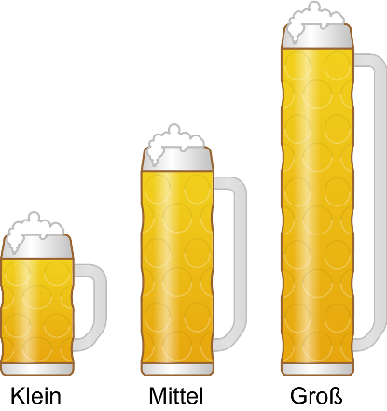
Ordinal Attributes
An ordinal attribute is an attribute with possible values that have a meaningful order or ranking among them, but the magnitude between successive values is not known.
Suppose that drink size corresponds to the size of drinks available at a fast-food restaurant.
This nominal attribute has three possible values:
small, medium, and large.
The values have a meaningful sequence (which corresponds to increasing drink size); however, we cannot tell from the values how much bigger, say, a medium is than a large.
Notes:
Because nominal attribute values do not have any meaningful order about them and are not quantitative, it makes no sense to find the mean (average) value or median (middle) value for such an attribute, given a set of objects.

Slide 11
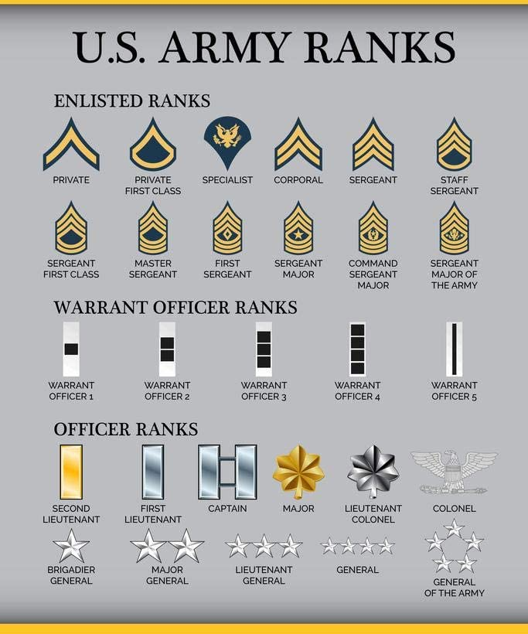

Ordinal Attributes
Professional ranks can be enumerated in a sequential order: for example, assistant, associate, and full for professors, and private, private first class, specialist, corporal, and sergeant for army ranks.
Notes:
Other examples of ordinal attributes include grade (e.g., A+, A, A-, B+, and so on) and professional rank.

Slide 12
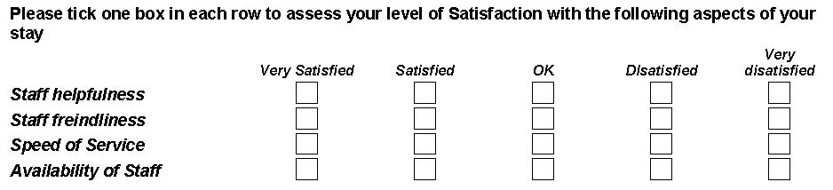
Ordinal Attributes
Ordinal attributes are useful for registering subjective assessments of qualities that cannot be measured objectively; thus ordinal attributes are often used in surveys for ratings.
In one survey, participants were asked to rate how satisfied they were as customers.
Customer satisfaction had the following ordinal categories: 0: very dissatisfied, 1: somewhat dissatisfied, 2: neutral, 3: satisfied, and 4: very satisfied
Notes:
Other examples of ordinal attributes include grade (e.g., A+, A, A-, B+, and so on) and professional rank.

Slide 13
Nominal, Binary, and Ordinal Attributes
Note that nominal, binary, and ordinal attributes are qualitative.
That is, they describe a feature of an object without giving an actual size or quantity.
The values of such qualitative attributes are typically words representing categories.
If integers are used, they represent computer codes for the categories, as opposed to measurable quantities (e.g., 0 for small drink size, 1 for medium, and 2 for large).
Notes:
Other examples of ordinal attributes include grade (e.g., A+, A, A-, B+, and so on) and professional rank.

Slide 14
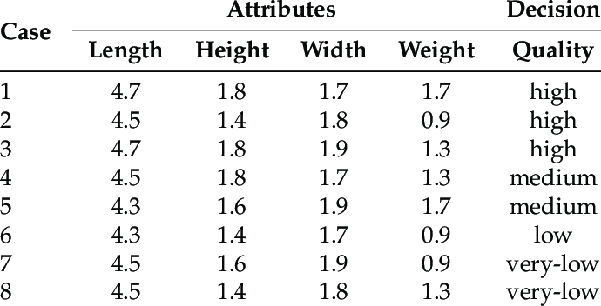
Numeric Attributes
A numeric attribute is quantitative; that is, it is a measurable quantity, represented in integer or real values.
Numeric attributes can be interval-scaled or ratio-scaled.
Notes:
Other examples of ordinal attributes include grade (e.g., A+, A, A-, B+, and so on) and professional rank.

Slide 15

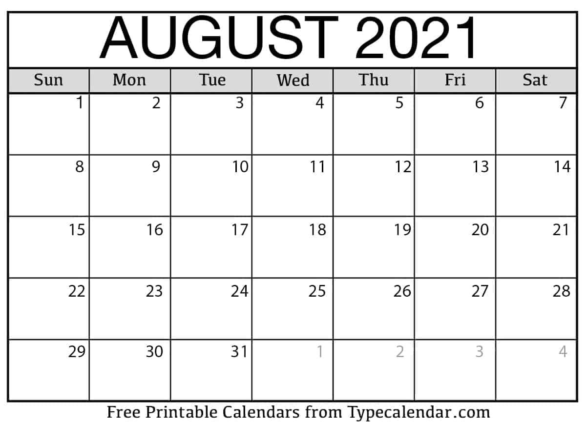
Interval-Scaled Attributes
Interval-scaled attributes are measured on a scale of equal-size units. The values of interval-scaled attributes have order and can be positive, 0, or negative.
Thus, in addition to providing a ranking of values, such attributes allow us to compare and quantify the difference between values.
For example
a temperature of 20C is five degrees higher than a temperature of 15C.
In calendar dates: the years 2002 and 2010 are eight years apart.
Notes:
Other examples of ordinal attributes include grade (e.g., A+, A, A-, B+, and so on) and professional rank.

Slide 16
Ratio-Scaled Attributes
A ratio-scaled attribute is a numeric attribute with an inherent zero-point. That is, if a measurement is ratio-scaled, we can speak of a value as being a multiple (or ratio) of another value.
In addition, the values are ordered, and we can also compute the difference between values, as well as the mean, median, and mode.
For example:
Unlike temperatures in Celsius and Fahrenheit, the Kelvin (K) temperature scale has what is considered a true zero-point (0K =-273.15C): It is the point at which the particles that comprise matter have zero kinetic energy.
Count attributes, such as years of experience for employees
number of words in a document
weight, height, latitude and longitude.
coordinates (e.g., when clustering houses),
monetary quantities (e.g., you are 100 times richer with $100 than with $1).
Notes:
Other examples of ordinal attributes include grade (e.g., A+, A, A-, B+, and so on) and professional rank.

Slide 17
Attributes
Nominal: categories, states, or “names of things”
Hair_color= {auburn, black, blond, brown, grey, red, white}
marital status, occupation, ID numbers, zip codes
Binary
Nominal attribute with only 2 states (0 and 1)
Symmetric binary: both outcomes equally important (e.g., gender)
Asymmetric binary: outcomes not equally important
medical test: positive vs. negative,
True/False
Convention: assign 1 to most important outcome (e.g., HIV positive)
Ordinal
Values have a meaningful order (ranking) but magnitude between successive values is not known.
Size = {small, medium, large}, grades, army rankings

Slide 18
Discrete Vs. Continuous Attributes
A discrete attribute has a finite or countably infinite set of values, which may or may not be represented as integers.
The attributes hair color, smoker, medical test, and drink size each have a finite number of values, and so are discrete.
Note that discrete attributes may have numeric values, such as 0 and 1 for binary attributes or, the values 0 to 110 for the attribute age.
If an attribute is not discrete, it is continuous.
The terms numeric attribute and continuous attribute are often used interchangeably in the literature.
Continuous attributes are typically represented as floating-point variables.
For example, a person's height could be any value (within the range of human heights), not just certain fixed heights, time in a race you could even measure it to fractions of a second, a dog's weight, or length of a leaf.
Notes:
Other examples of ordinal attributes include grade (e.g., A+, A, A-, B+, and so on) and professional rank.

